Slide 1
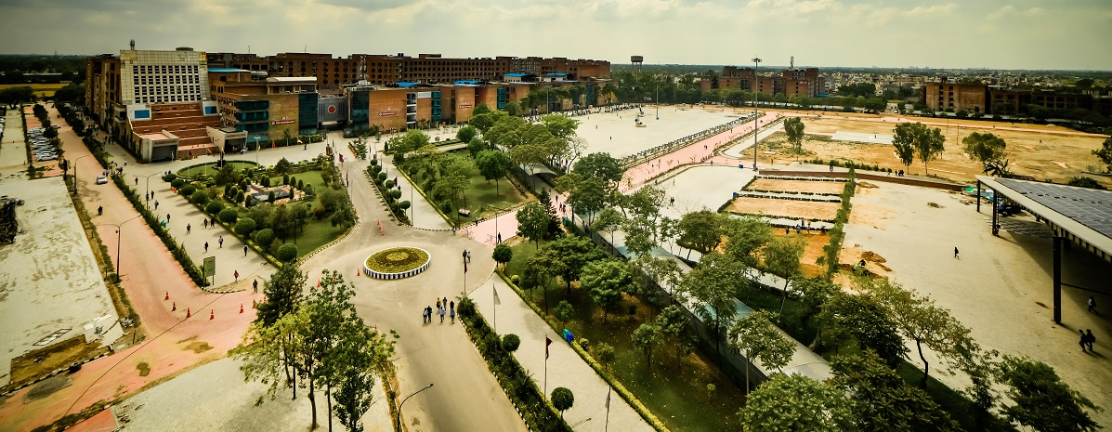
Welcome!
Notes:
Welcome the students with full enthusiasm

Slide 2

Why did you decide to join CSE ?

Slide 3

Let’s go back
A. Idea/Thought
B. Guidance
C. Attraction/ Success
D. Passion/Career
E. Happiness
Notes:
In this series the, very first thing was the idea to choose a career path after your +2 or intermediate. Then there was a deep thought over which stream of education to choose, but keeping the choices in the mind would have led to some confusions too. Seeking guidance to clear you doubts to make a clear choice was what most of you would have done. But an attraction to the world ahead always caught your attention. The hunger to succeed the passion to get a super successful career and the happiness on the faces of our parents were the dreams that did not let you sleep many times at night. After all those days of anxiety and stress you finally made a choice to be where you are today!

Slide 4

Notes:
But this is not the end, it’s a beginning. The beginning of the most important phase of your life. A phase where the only constant is “change.” But caution! Change is not easy. It won’t happen in a day and it will not happen without some specific inputs- dedication, determination and constant effort.

Slide 5


You did
Notes:
You took first step towards your career journey by doing “Goal setting”and “SWOT” analysis in the beginning of first semester to get clarity on which career path to follow.

Slide 6

Excited about it?
Notes:
Are you excited to know more about various career pathways that you can opt for after graduation ?

Slide 7


Have you thought about it?
Notes:
Ask if they know the career pathways available for Engineers. Get their answers and then go to next slide

Slide 8

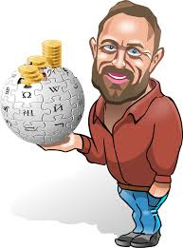




Major Career Pathways
A B C D E F
Corporate/Industry
Entrepreneurship
Higher Studies
Research
PSU/ Competitive Exams/Defence
Sports & Athletics
Notes:
Add examples as per the domain of the students relating to each career.

Slide 9

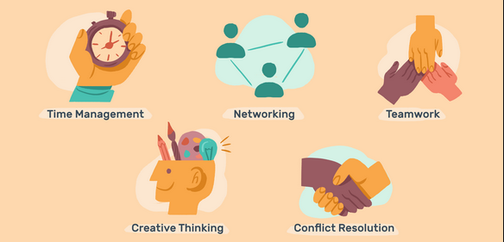
How would you reach there?
+
Hard Skills Soft Skills
Notes:
This achievements that we have been talking about will happen by learning skills that are broadly classified as hard skills i.e technical skills and Soft Skills.

Slide 10

We will enhance your Soft Skills

Slide 11
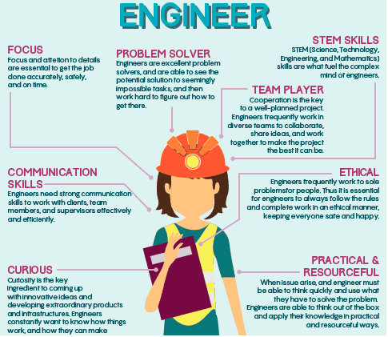
Which Soft Skills are we referring to?
Focus
Communication Skills
Curiosity
Problem Solving
Teamwork
Ethics
Practicality
STEM Skills
Notes:
To be a IT professional one needs laser focus, a very proficient level of communication, a lot of curiosity that keeps your hunger to learn always high. Along with that one also needs to be an ace problem solver with an ability to work in a team so that the work can be done quickly with less errors and high level of creativity. But one attribute that is globally respected are the strong ethics and honesty. Practicality in handling tough situation and taking the right decisions at the right time is also required along with your Science technology engineering and mathematical skills that fuel your mind to productivity.

Slide 12
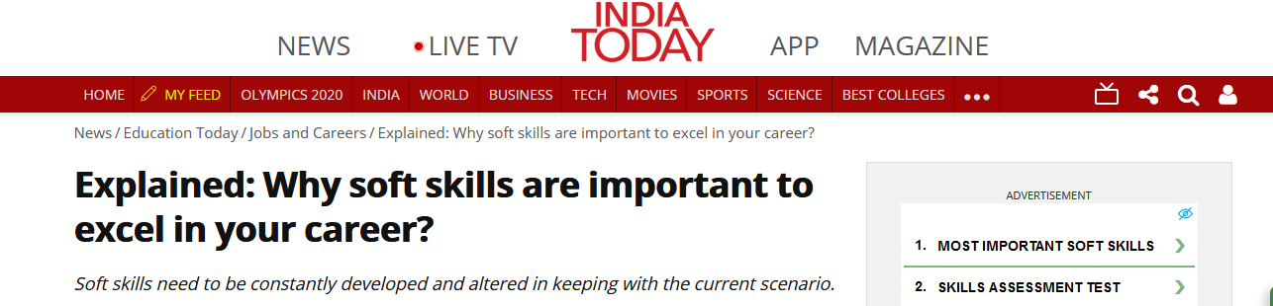
Notes:
Not just that but here’s what our Indian business houses say about in the importance of soft skills. Link for detailed article>> https://www.indiatoday.in/education-today/jobs-and-careers/story/explained-why-soft-skills-are-important-to-excel-in-your-career-1791623-2021-04-16

Slide 13

Soft Skills – PES 319
The upcoming journey
Notes:
Hence, after a lot of thought, focused research and industry feedback we at Lovely Professional University decided to give our vertos an edge over their competition globally by training them and giving them a chance to hone their soft skills with proper mentoring and handholding via the course added in your degree. The Course code for this is PES 319 and the course title is Soft Skills.

Slide 14
During the semester four Academic Tasks will be conducted.
Kindly note all the Academic Tasks are mandatory.
Soft Skills – PES 319

Slide 15









Course weightage
10 Marks
40 Marks
NA
50 Marks
Notes:
Along with that you shall have marks on attendance and an End Term Practical exam to see your final growth by the end of the semester.

Slide 16

Some ground rules
Be punctual
Be participative
Be Updated
Be curious
Be skilled
Practice, practice and practice!
Notes:
The ground rules to be successful and upskilled after this course are: punctuality, participation, curiosity, constant improvement of your skills and last but not the least practice till you master the skill.

Slide 17

Notes:
For all your doubts and questions we shall meet you in the online classes where you can clear your doubts and ask us all your queries. Remember the more you ask means more you learn!

Slide 18

Notes:
Thank you and see you soon!

